Slide 1

QUEEN CITY CON 0x4 · NOVEMBER 2026
When the
sensor lies
How attackers turn industrial control systems against the physical world
David G. Moad · M.S. Cybersecurity, Northern Kentucky University
Photo: Zonk43 · Public domain · Wikimedia Commons
Notes:
Hook: every industrial system you depend on (power, water, the infusion pump in a hospital) makes decisions based on what its sensors tell it. This talk is about what happens when an attacker controls what the sensor says. Later I will show it live on a lab I built.

Slide 2

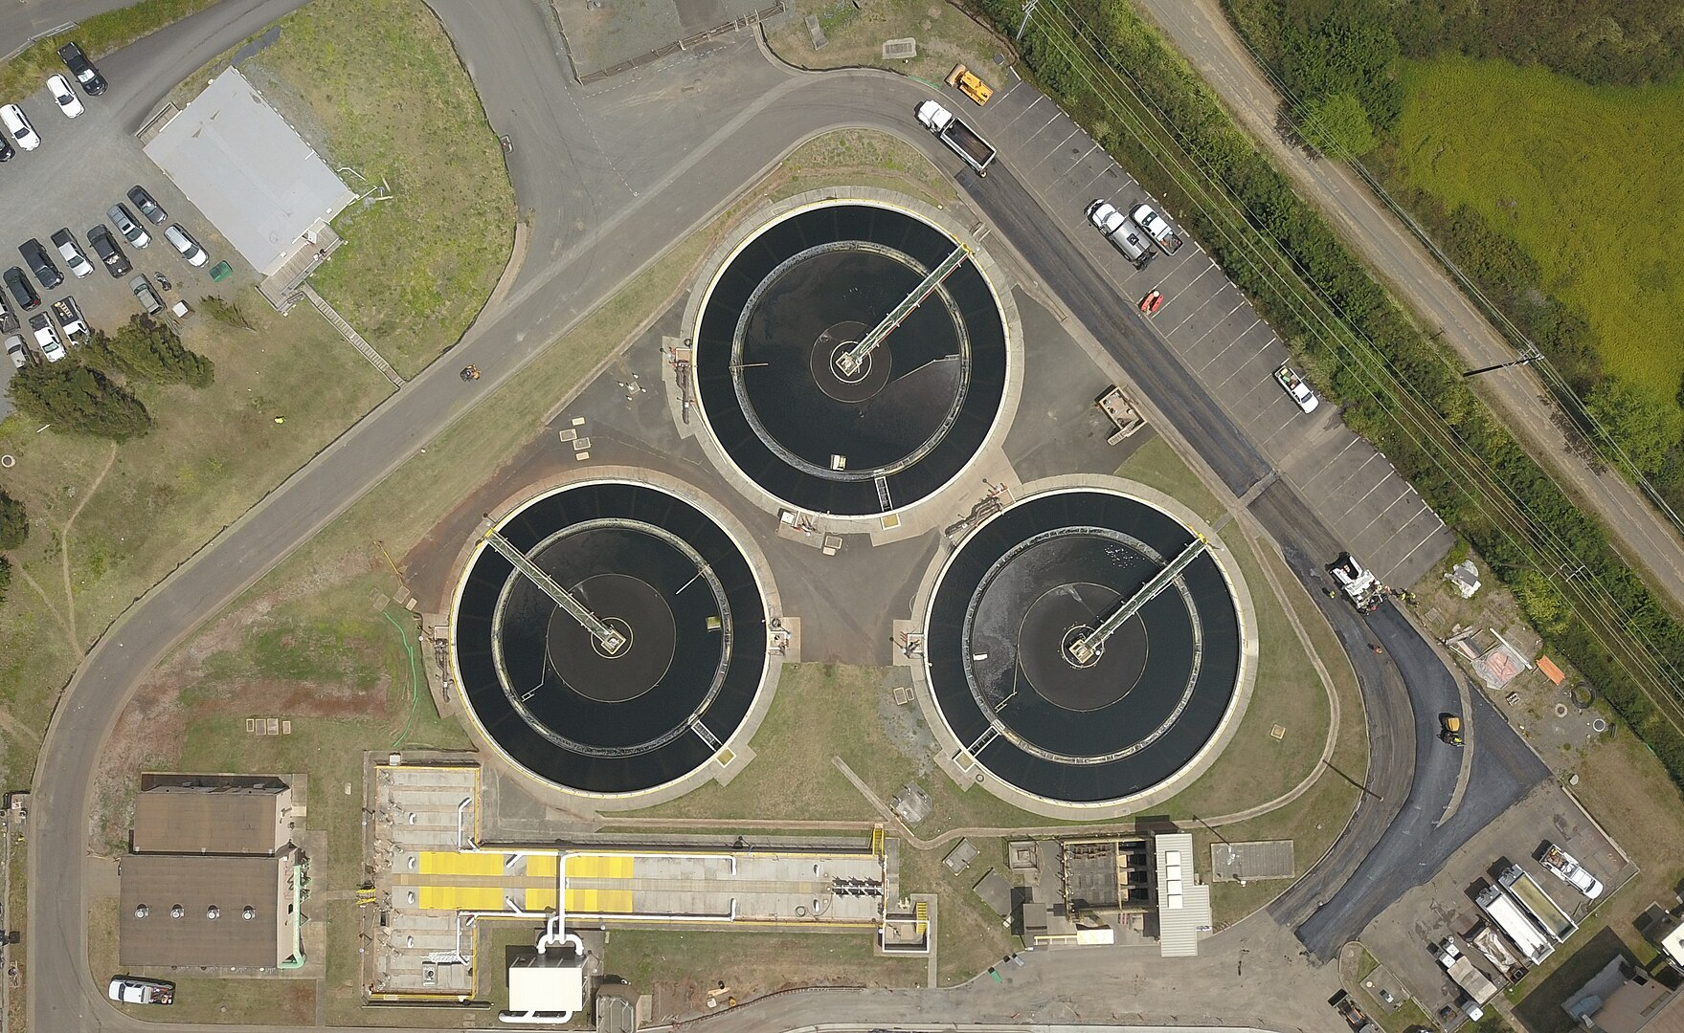

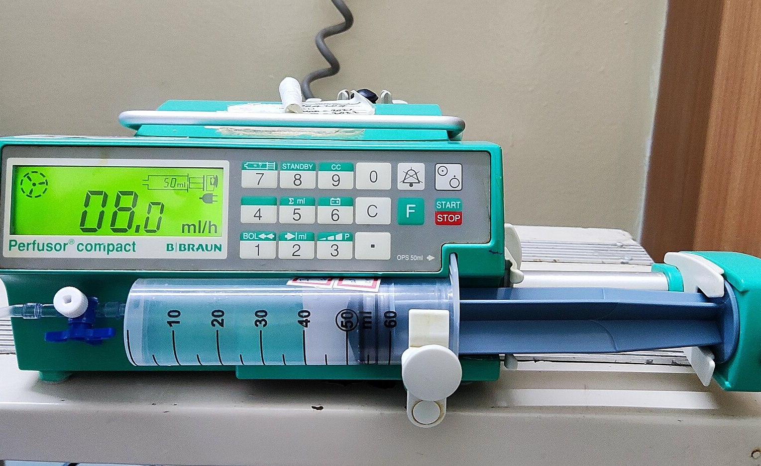
OT moves physical things
Operational technology is the hardware and software that monitors and controls a physical process: valves, pumps, motors, breakers, dosing systems. When OT fails, something in the real world changes.
Energy
Water
Manufacturing
Healthcare
Substations, grid protection, generation control
Treatment, chemical dosing, pumping stations
Production lines, robotics, process control
Infusion pumps, building systems, bedside devices
Photos via Wikimedia Commons: Wikideas1 (CC0) · Roen Wainscoat (CC BY-SA 4.0) · Clemenspool (CC0) · Shyamal (CC BY-SA 4.0)
QUEEN CITY CON 0x4 · 02
Notes:
Most of the room lives in IT. OT is the stuff that touches the physical world. A hospital is full of it even if nobody calls it OT: infusion pumps, building management, medical IoT. Healthcare is highlighted because that is where this talk lands.

Slide 3
Same attacks, different stakes
 | IT | OT
Top priority | Confidentiality | Safety, then availability
A bad day looks like | Data breach, outage | Physical damage, injury, death
Patching | Routine, automated | Planned outages, sometimes never
Asset lifespan | A few years | Often decades
Protocols | Authenticated by default | Many legacy protocols have none
QUEEN CITY CON 0x4 · 03
Notes:
The techniques overlap with IT: phishing, exposed services, stolen credentials. What changes is the consequence. In IT the worst case is usually data; in OT it is a physical event. That flips priorities: you cannot reboot a controller mid-process to patch it, and equipment stays in service for decades.

Slide 4
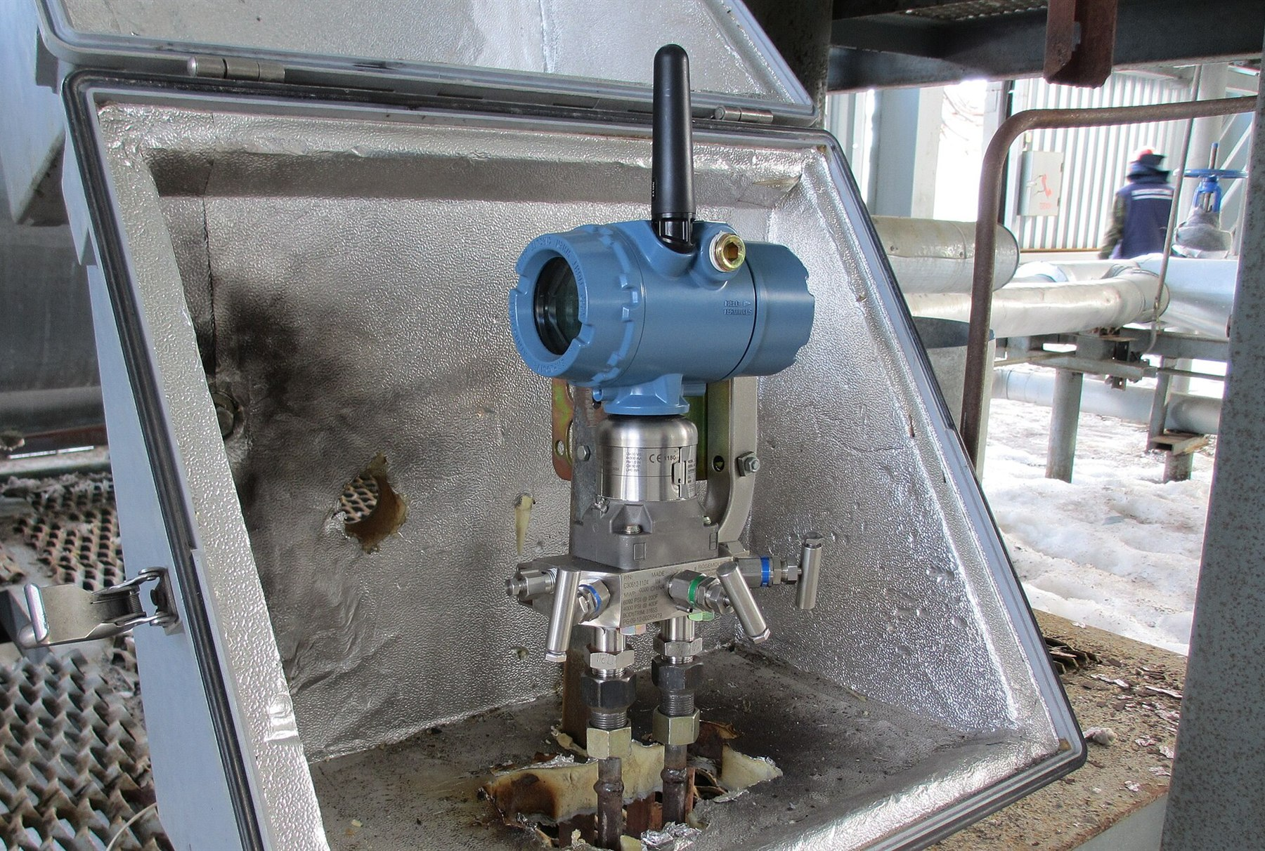
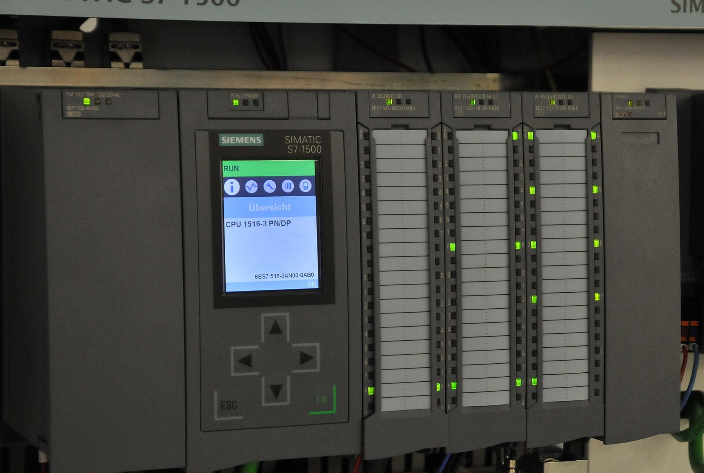
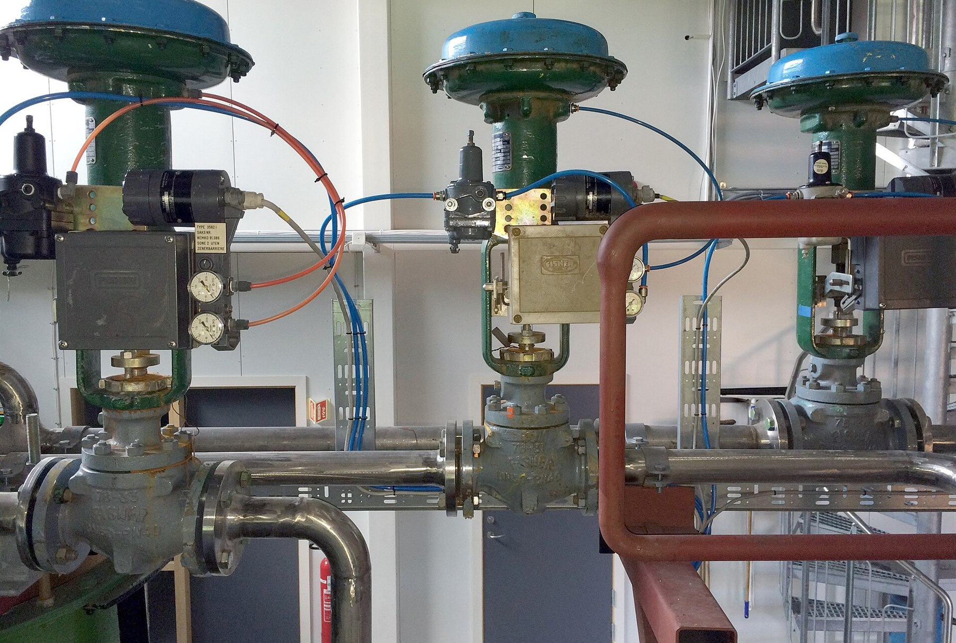

Every OT system is a control loop
→
→
→
Sensor
Controller
Actuator
Process
Measures the process
Compares the reading to a setpoint
Changes the process
Feeds back to the sensor
The controller only knows what the sensor tells it. Control the reading, and you control the process.
Photo: Weberman2010 · CC BY-SA 4.0 · Wikimedia Commons
Also: Palatinatian (CC BY 3.0) · Bitjungle (CC BY-SA 4.0) · FoxyStranger Kawasaki (CC BY-SA 3.0)
QUEEN CITY CON 0x4 · 04
Notes:
This is the slide the rest of the talk hangs on. Strip away the vendor names and every OT system reduces to this loop. The controller has no independent knowledge of the world. If an attacker can change what the controller believes the sensor said, they drive the actuator without ever touching it.

Slide 5
How OT networks are built
The Purdue model layers an industrial network so that enterprise IT never talks straight to the process. Segmentation between the layers is the classic defense.
Level 4–5
Enterprise IT
Email, ERP, the internet
Level 3
Site operations
Historians, patch servers, monitoring
Level 2
Supervisory control
HMIs, SCADA servers, engineering workstations
Level 1
Basic control
PLCs, RTUs, safety controllers
Level 0
Physical process
Sensors, actuators, motors, valves
QUEEN CITY CON 0x4 · 05
Notes:
Keep this quick; most of a security crowd knows Purdue. The point: an attacker with a foothold at Level 2, on an HMI or an engineering workstation, can talk directly to the controllers below. Segmentation is the classic defense, but once you can reach the controller input it is not enough on its own.

Slide 6
Protocols that never ask “who are you?”
Modbus (1979)
MODBUS/TCP · FUNCTION 06 · WRITE SINGLE REGISTER
No authentication field anywhere in the message. Still everywhere.
00 01 00 00 00 06 01
06 00 00 04 4C
DNP3
Utilities’ workhorse. A Secure Authentication version exists; most deployed devices don’t use it.
header: transaction, protocol, length, unit 1
write register 0 (40001) = 1100
BACnet
No username. No password. No signature. Any host that can reach port 502 can send it.
Building automation (HVAC, access, hospitals). A secure variant (BACnet/SC) is new and rare in the field.
“Many OT protocols have no authentication at any level.”
NIST SP 800-82 Rev. 3 (2023)
Source: Modbus Organization, “What is Modbus?” (Modicon, 1979) and Modbus Application Protocol Spec v1.1b3; NIST SP 800-82 Rev. 3, Guide to OT Security (Sept 2023)
QUEEN CITY CON 0x4 · 06
Notes:
This is a complete, valid Modbus command: set holding register 0 on unit 1 to 1100. That might be a pump speed or a chlorine setpoint. Nothing in it identifies who sent it, and the device will obey any host that can reach TCP 502. Newer secure variants of DNP3 and BACnet exist, but the installed base is decades old.

Slide 7
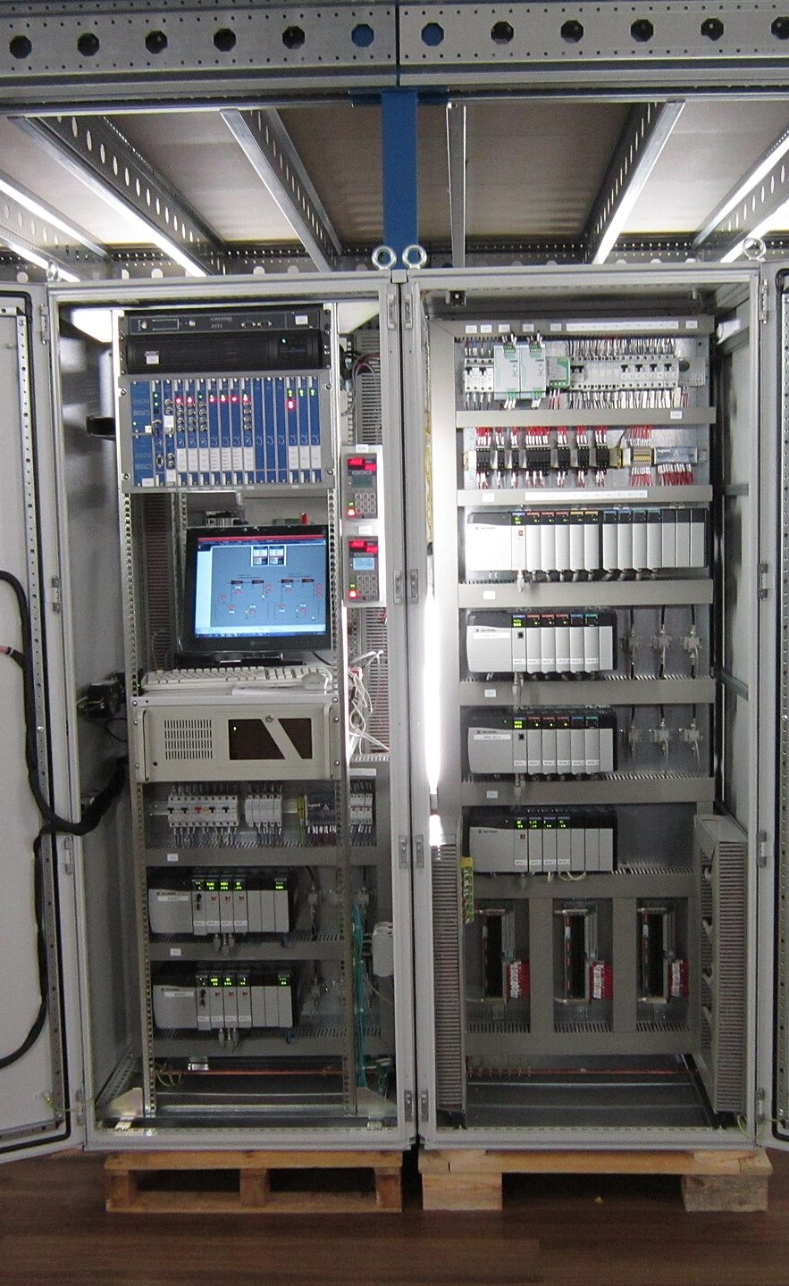
THE ROOT CAUSE
OT trusts its inputs because, for decades, the wire was the trust boundary.
If you were on the serial line, you were already inside the fence. That assumption survived the move to Ethernet and IP. The fence did not.
Photo: DWI · CC BY-SA 3.0 · Wikimedia Commons
Notes:
Legacy OT protocols have no authentication because physical access was the control. Ethernet and wireless kept the trusting protocols and threw away the physical boundary. Every attack in the rest of this talk exploits that gap.

Slide 8
Four ways attackers lie to the physics
1
Feed the controller false data
2
Change the goal
Tell it the tank is empty and it keeps filling. Tell it the pressure is low and the pump keeps running.
Rewrite a setpoint or command the actuator directly. The controller faithfully drives to the wrong target.
3
Blind the operator
4
Disable the safety net
Replay normal readings to the HMI while the process goes wrong. The screens look fine.
Reprogram or silence the safety system, the last automated layer that prevents an explosion.
QUEEN CITY CON 0x4 · 08
Notes:
Every real OT attack is one or more of these. Number one is the one I am about to show you live. Number three is Stuxnet. Number four is Triton.

Slide 9
LIVE DEMONSTRATION
Lie #1, live
False sensor data against two pressure controllers
QUEEN CITY CON 0x4 · 09
Notes:
Switch to the lab. Run the demo, then come back to the incident slides: "That was a lab. Here is what it looks like when it is real."

Slide 10
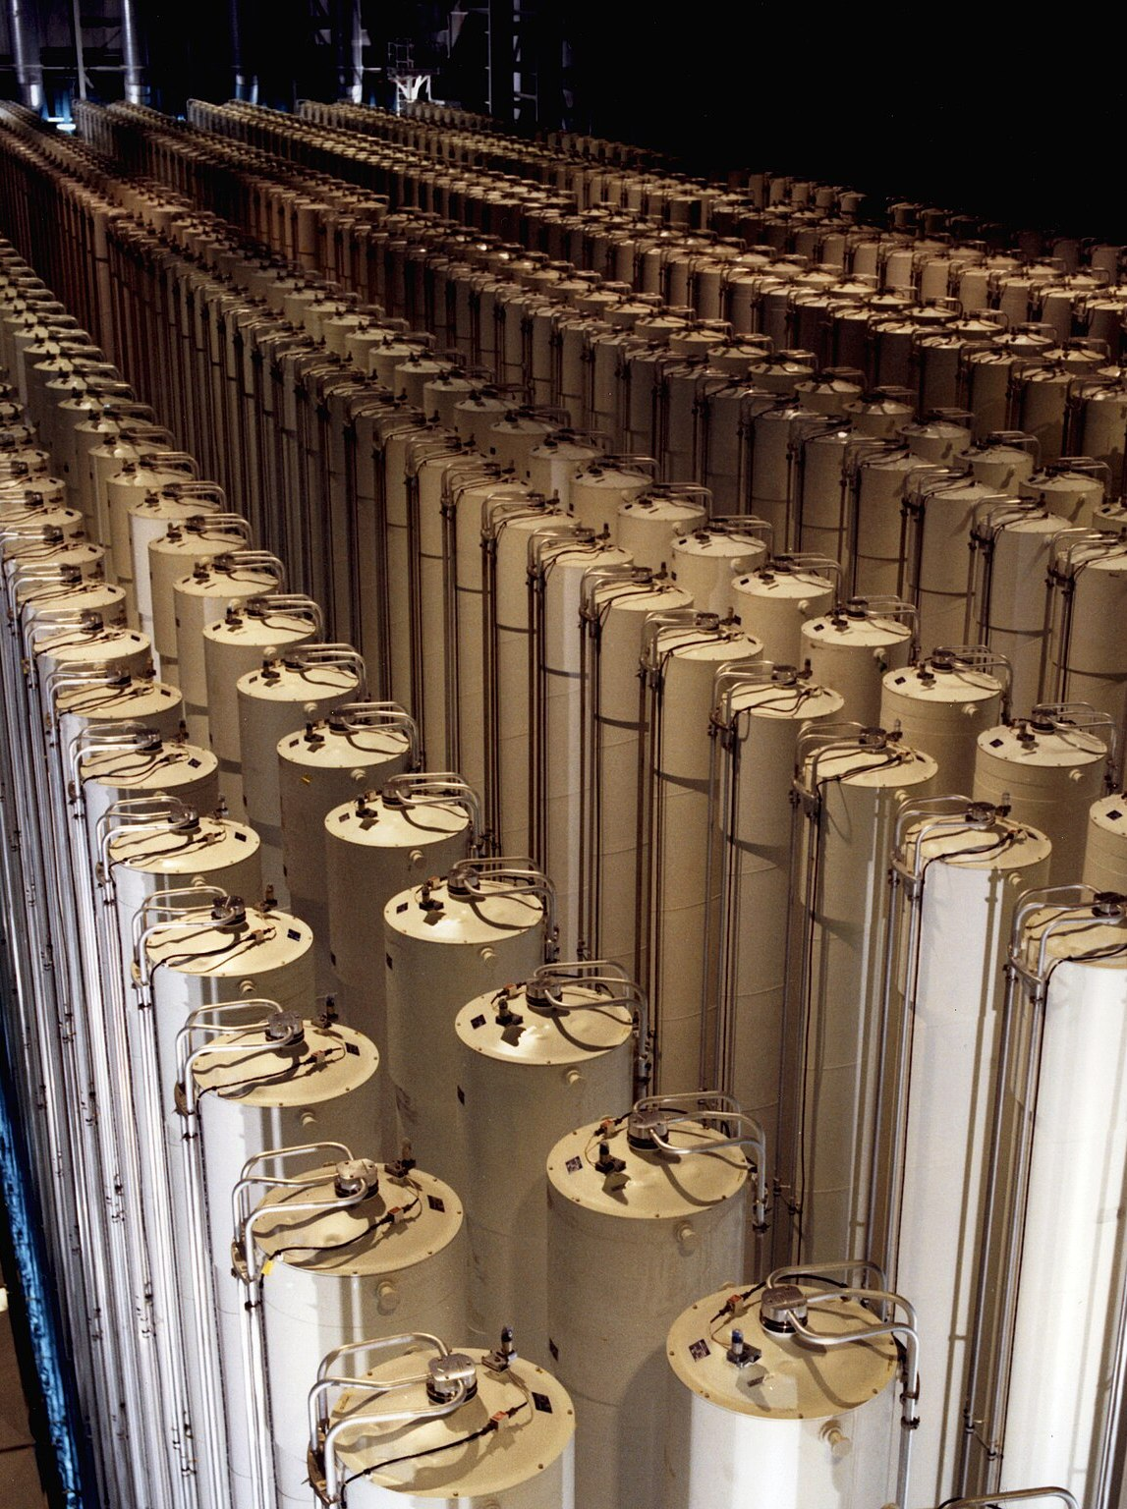
2007–2010 · NATANZ, IRAN
Stuxnet
Reprogrammed Siemens PLCs driving uranium-enrichment centrifuges [Symantec 2011]
Pushed rotor speeds outside safe limits to stress and break them [Langner 2013]
Replayed recorded “normal” values to operators, so the screens looked fine [Symantec 2011]
An estimated ~1,000 centrifuges were decommissioned and replaced; Iran never confirmed the cause [ISIS 2010]
LIES #2 AND #3: CHANGE THE GOAL, BLIND THE OPERATOR
Source: Symantec, “W32.Stuxnet Dossier” (2011); R. Langner, “To Kill a Centrifuge” (2013); D. Albright, P. Brannan, C. Walrond, “Did Stuxnet Take Out 1,000 Centrifuges at the Natanz Enrichment Plant?”, ISIS (Dec 22, 2010)
Photo: U.S. Department of Energy · Public domain · Wikimedia Commons
QUEEN CITY CON 0x4 · 10
Notes:
The canonical false-data attack. The physical damage happened while operators watched dashboards that said everything was normal. The 1,000 figure is ISIS's estimate from IAEA inspection data: "Iran decommissioned and replaced about 1,000 IR-1 centrifuges". Iran never admitted Stuxnet caused it, so say "estimated".

Slide 11

DECEMBER 2015 & 2016 · UKRAINE
Grid attacks
2015: attackers came in over VPN and used the utilities’ own SCADA HMIs to open breakers at 27+ substations [E-ISAC/SANS 2016]
About 225,000 customers lost power for several hours [CISA 2016; E-ISAC/SANS 2016]
They corrupted serial-to-Ethernet firmware so operators couldn’t simply undo it remotely [CISA 2016]
2016: Industroyer spoke grid protocols (IEC 101/104, IEC 61850, OPC DA) directly, and was likely behind that December’s outage [ESET 2017]
LIE #2: CHANGE THE GOAL, ISSUED STRAIGHT TO THE GRID
Source: CISA, IR-ALERT-H-16-056-01 “Cyber-Attack Against Ukrainian Critical Infrastructure” (2016); E-ISAC & SANS ICS, “Analysis of the Cyber Attack on the Ukrainian Power Grid” (Mar 18, 2016); ESET, “Win32/Industroyer” (Jun 12, 2017)
Photo: Novoklimov · CC0 · Wikimedia Commons
QUEEN CITY CON 0x4 · 11
Notes:
The first confirmed power outages caused by a cyberattack. CISA: "impacting approximately 225,000 customers". E-ISAC/SANS: "the adversaries used the HMIs in the SCADA environment to open the breakers. At least 27 substations ... were taken offline" and the outages "lasted for several hours". In 2016 the malware did not need a human at the HMI; it spoke the substation protocols itself. ESET called it "a very probable explanation" for the Dec 17, 2016 outage.

Slide 12

2017 · SAUDI ARABIA
Triton / TRISIS
Targeted Schneider Electric Triconex safety instrumented system (SIS) controllers at a petrochemical plant [Mandiant 2017]
The SIS is the last automated layer that shuts a plant down before an explosion or toxic release
Found because controllers “entered a failed safe state” and automatically shut the process down [Mandiant 2017]
The goal wasn’t theft or disruption: it was to remove the system that keeps people alive
LIE #4: DISABLE THE SAFETY NET
Source: Mandiant (FireEye), “Attackers Deploy New ICS Attack Framework ‘TRITON’ …” (Dec 14, 2017). Location: reporting on the 2022 US indictment of E. Gladkikh (CyberScoop, TechCrunch, Mar 2022)
Photo: FoxyStranger Kawasaki · CC BY-SA 3.0 · Wikimedia Commons
QUEEN CITY CON 0x4 · 12
Notes:
This is the one that should scare people. Mandiant: "some SIS controllers entered a failed safe state, which automatically shutdown the industrial process". Mandiant did not name the site; Saudi Arabia comes from reporting around the March 2022 US indictment of Evgeny Gladkikh.

Slide 13
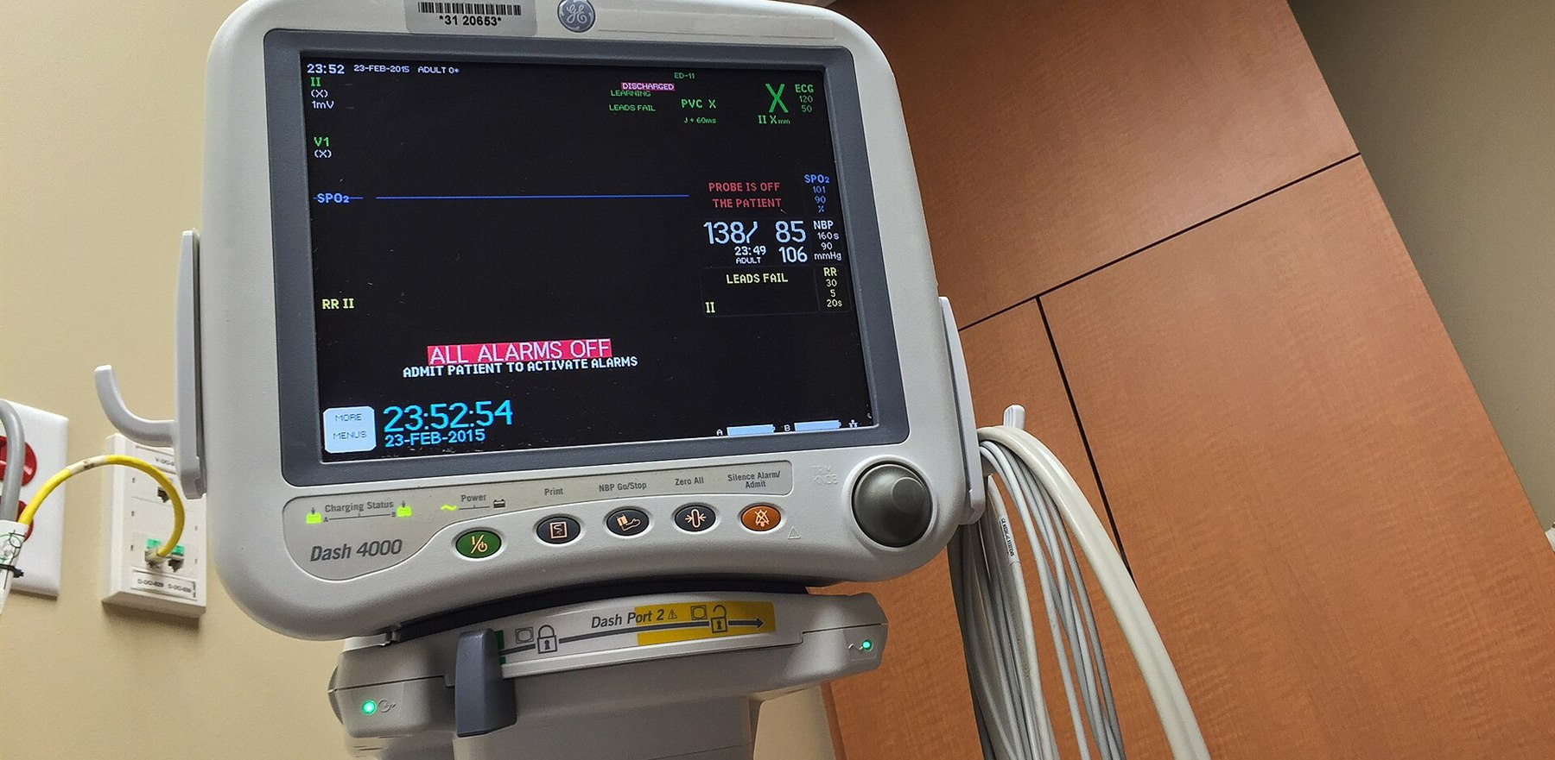
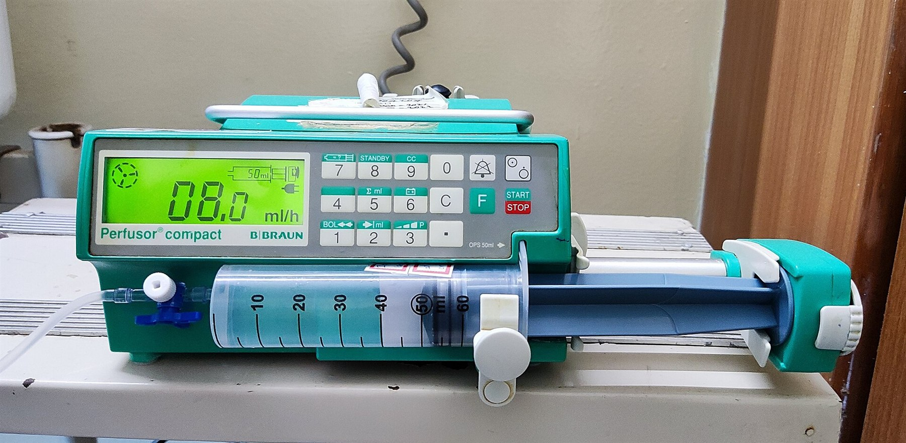
Hospitals are OT too
2015
FDA urges hospitals to stop using Hospira Symbiq infusion pumps: an unauthorized user on the network could change the dose. [FDA, Jul 31 2015]
2017
About 465,000 Abbott (St. Jude) pacemakers in the US need a firmware update to block unauthorized commands. [FDA, Aug 29 2017]
2019
Some Medtronic MiniMed insulin pumps can’t be patched; FDA tells patients to switch to newer models. [FDA, Jun 27 2019]
Photo: Tony Webster from San Francisco, California · CC BY 2.0 · Wikimedia Commons
2021
“PwnedPiper”: flaws in Swisslog Translogic pneumatic-tube systems, used in 80%+ of North American hospitals. [Armis, Aug 2 2021]
Sources: FDA safety communications (Hospira Symbiq, Jul 31 2015; Abbott pacemakers, Aug 29 2017; Medtronic MiniMed, Jun 27 2019); Armis, “PwnedPiper” (Aug 2 2021). Full list on the last slide.
Photo: Shyamal · CC BY-SA 4.0 · Wikimedia Commons
QUEEN CITY CON 0x4 · 13
Notes:
Ties it back to healthcare. An infusion pump is a control loop: a setpoint (dose), an actuator (the pump), sensors. Same failure modes as a refinery, at the bedside. Building systems (HVAC, pneumatic tubes, pharmacy cabinets) are OT too.

Slide 14
Seeing it: OT detection
01
02
03
Passive network monitoring
Process-aware detection
Correlate and alert
Copy traffic from a mirror port or tap; never inject packets into a live process. Parse Modbus and DNP3 and alert when an unexpected host writes to a controller.
→
Check readings against physics: impossible values, impossible rates of change, disagreement between redundant sensors. A reading is a claim, not a fact.
→
Send network, process and host events to one place (a SIEM) so an operator sees “attack in progress”, not just “odd reading”.
QUEEN CITY CON 0x4 · 14
Notes:
A controller that silently rejects bad data is safe but blind. Detection has to cover the network and the physics. Passive monitoring matters in OT because active scanning can crash fragile controllers.

Slide 15
Defending it
Validate against physics
Bounds, rate-of-change and redundant-sensor checks before a reading drives an actuator.
Keep an independent source of truth
A sensor or safety system the network can’t reach: hardwired, separate, and not reprogrammable remotely.
Segment with allowlists
Zones and conduits; a DMZ between IT and OT; only known hosts may write to controllers.
Authenticate where you can
MFA on remote access, secure protocol variants, signed firmware and configuration changes.
Plan for the bad day
Manual fallback procedures, offline backups of controller logic, tested restores.
Frameworks: ISA/IEC 62443 · NIST SP 800-82 Rev. 3 · CISA ICS advisories
QUEEN CITY CON 0x4 · 15
Notes:
Validation is what saved the second controller in the demo: it had a sensor the attacker could not reach. The rest is standard OT hygiene: IEC 62443 zones and conduits, and NIST SP 800-82 Rev. 3, the 2023 OT security guide.

Slide 16
What to take back to real OT
1
Validate inputs against physics. A reading that breaks a rate limit or disagrees with a redundant sensor is an alert, not a command.
2
Keep an independent source of truth. Systems survive when they have a sensor the attacker can’t reach.
3
Segment, but don’t rely on it alone. Assume the attacker is already at the supervisory layer, and design the controller to defend itself.
4
Monitor the physical layer. Wire sensor rejections and anomalies into the SIEM, so a safe system is also a visible one.
QUEEN CITY CON 0x4 · 16
Notes:
Number one is the whole talk: in OT, an input is a claim, not a fact. These generalize from a bottle to any sensor-driven process.

Slide 17
THANK YOU
A controller is only as honest as its sensors.
In OT, every input is a claim. Make your systems ask whether it’s true.
The lab, code and docs: github.com/moaderboat/Hospital-IoT-HomeLab
David G. Moad · M.S. Cybersecurity, NKU · moadd1@mymail.nku.edu
Notes:
Close on the one-liner. Point people to the repo for the full lab. Invite questions.

Slide 18
Sources
Stuxnet
Symantec, “W32.Stuxnet Dossier” v1.4 (Feb 2011) · R. Langner, “To Kill a Centrifuge” (Nov 2013) · D. Albright, P. Brannan, C. Walrond, “Did Stuxnet Take Out 1,000 Centrifuges at the Natanz Enrichment Plant?”, Institute for Science and International Security (Dec 22, 2010)
Ukraine 2015
CISA (ICS-CERT), IR-ALERT-H-16-056-01 “Cyber-Attack Against Ukrainian Critical Infrastructure” (2016) · E-ISAC & SANS ICS, “Analysis of the Cyber Attack on the Ukrainian Power Grid: Defense Use Case” (Mar 18, 2016)
Ukraine 2016
A. Cherepanov, ESET, “Win32/Industroyer: A new threat for industrial control systems” (Jun 12, 2017)
Triton
B. Johnson et al., Mandiant/FireEye, “Attackers Deploy New ICS Attack Framework ‘TRITON’ and Cause Operational Disruption to Critical Infrastructure” (Dec 14, 2017) · US DOJ indictment of E. Gladkikh, unsealed Mar 24, 2022 (as reported by CyberScoop and TechCrunch)
Healthcare
FDA safety communications: Hospira Symbiq infusion system (Jul 31, 2015); Abbott (St. Jude) pacemaker firmware update (Aug 29, 2017); Medtronic MiniMed insulin pumps (Jun 27, 2019) · Armis, “PwnedPiper” (Aug 2, 2021)
Protocols
Modbus Organization, “What is Modbus?” FAQ; Modbus Application Protocol Specification v1.1b3 · NIST SP 800-82 Rev. 3, “Guide to Operational Technology (OT) Security” (Sept 2023) · ISA/IEC 62443 series
Photos
Wikimedia Commons; author and license credited on each slide (public domain, CC0, CC BY, CC BY-SA)
QUEEN CITY CON 0x4 · 18
Notes:
Reference slide; leave it up during Q&A if people want to take photos.

